Slide 1




Career Development
Career Exploration with SDMyLife

Slide 2
Objectives
1
2
3
Understand how self assessments are a useful tool to determine future career paths.
Complete the Skills Lab, Matchmaker, Personality Style, Learning Style and Mission Complete assessments to identify which of the 16 career clusters is the best fit.
Evaluate the results of the self-assessments and research corresponding careers from a filtered list.

Slide 3
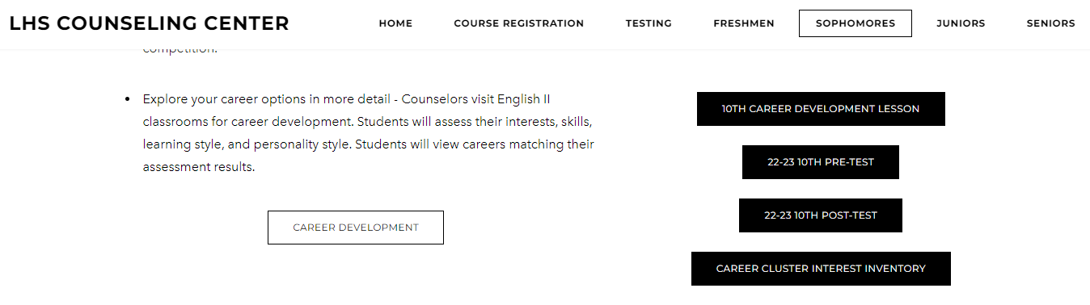
LHScounseling.com

Slide 4

16 Career Clusters

Slide 5


Slide 6
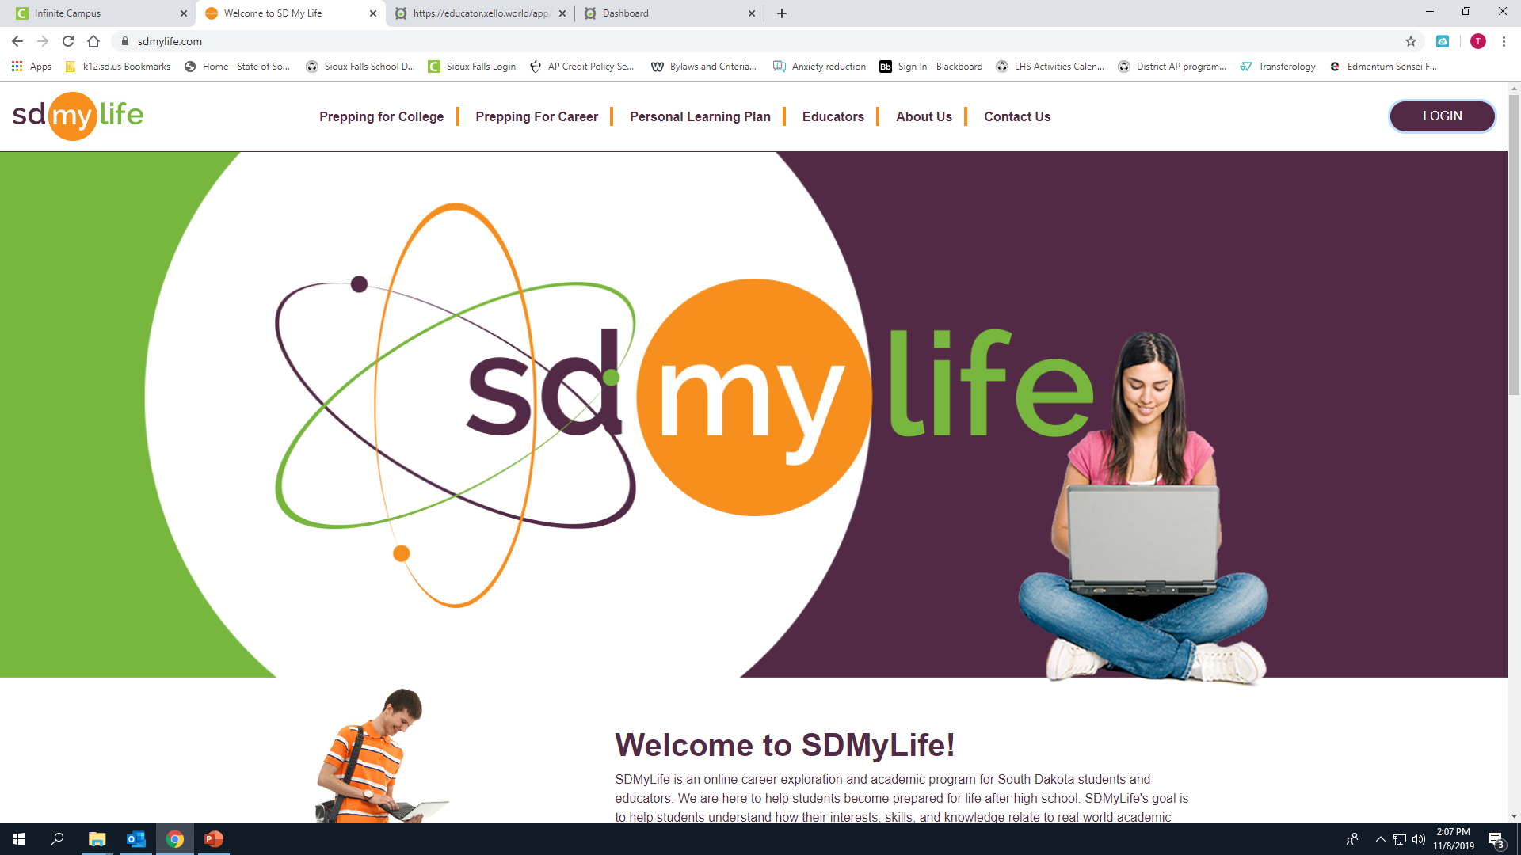
SDMyLife.com

Slide 7
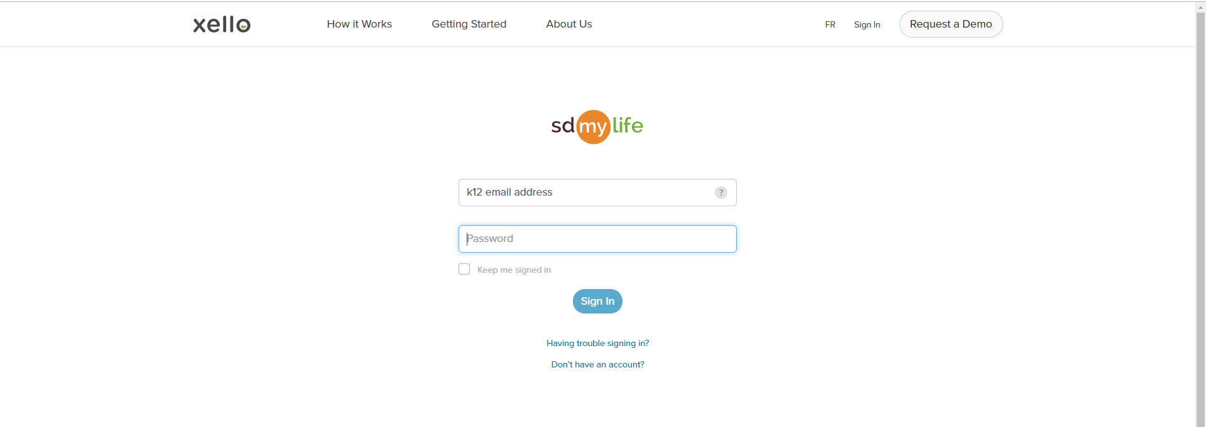
Username: k12 email
Password: Chromebook log in password
First letter of your first name capitalized
First letter of your last name lower case
student ID #
4-digit birth year

Slide 8
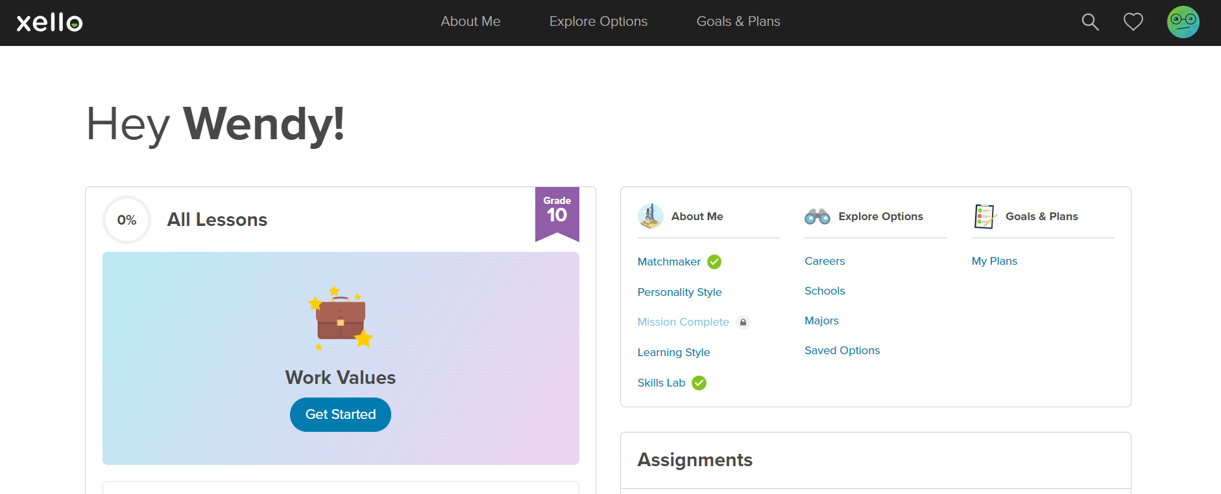
Complete all lessons under the “ABOUT ME” section

Slide 9
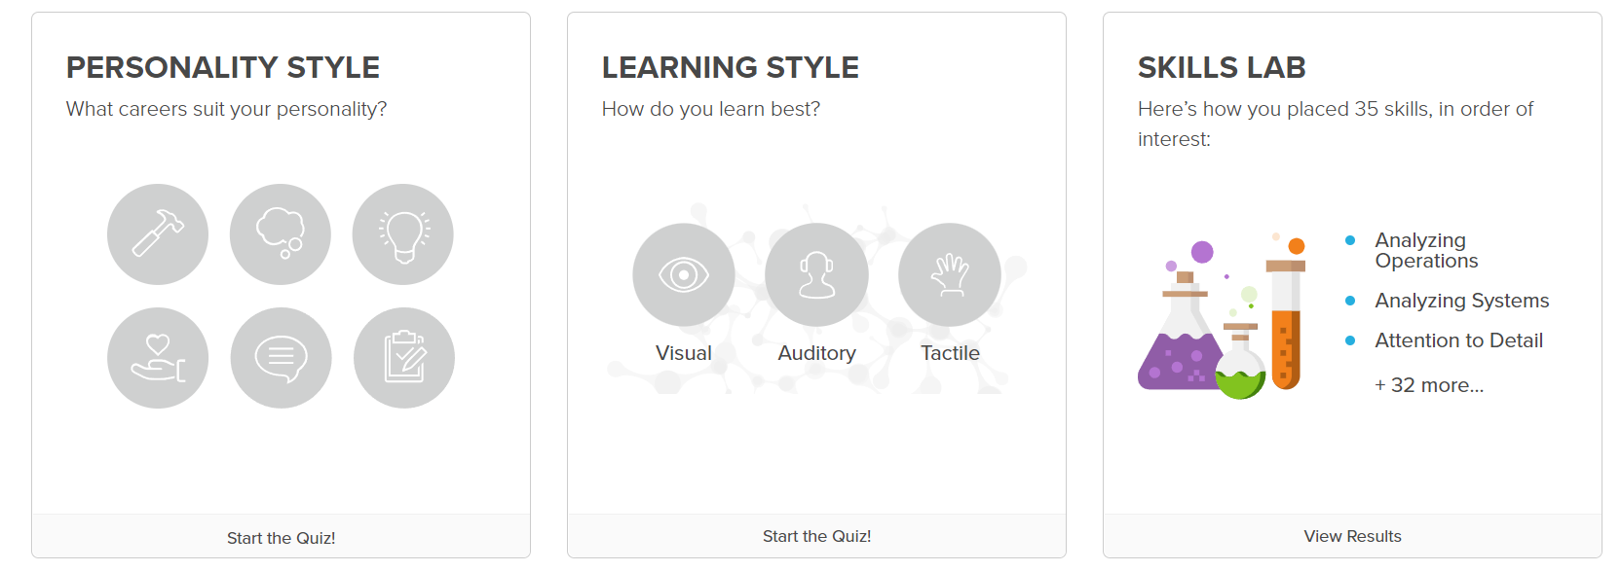

Slide 10
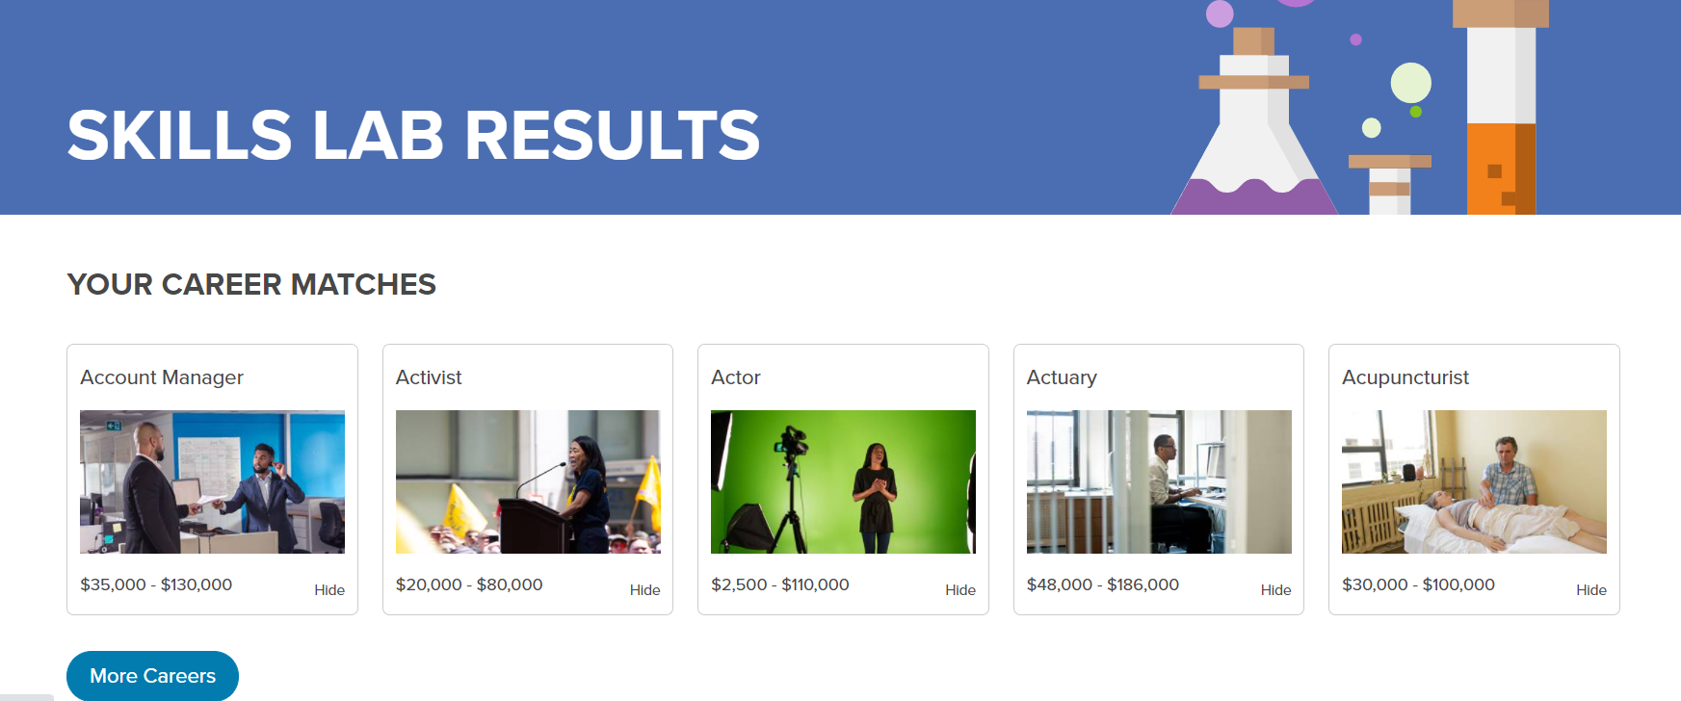

Slide 11
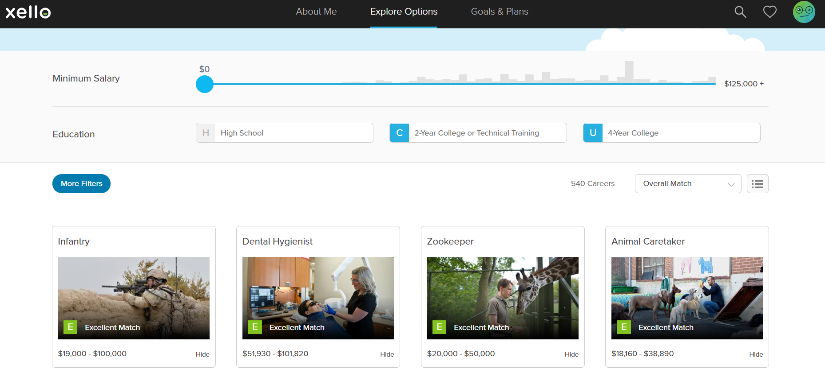

Slide 12
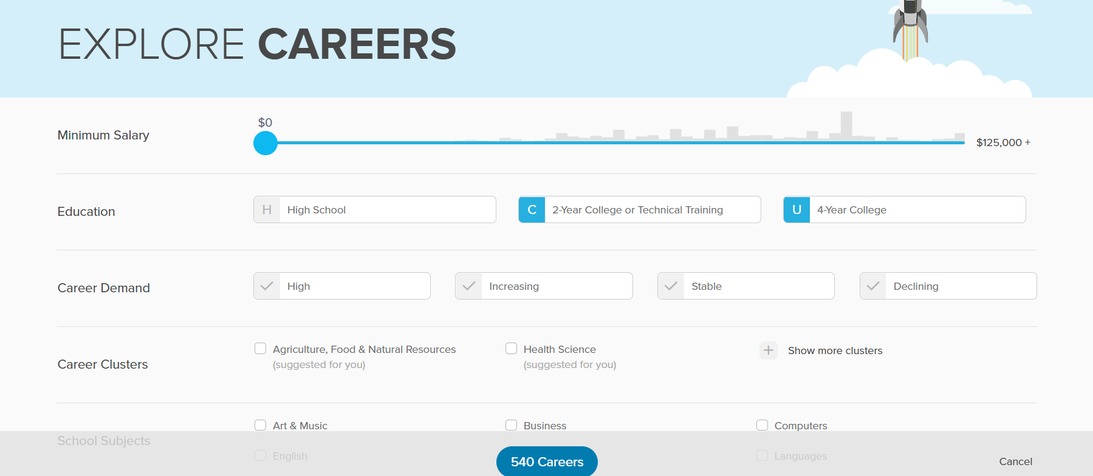

Slide 13
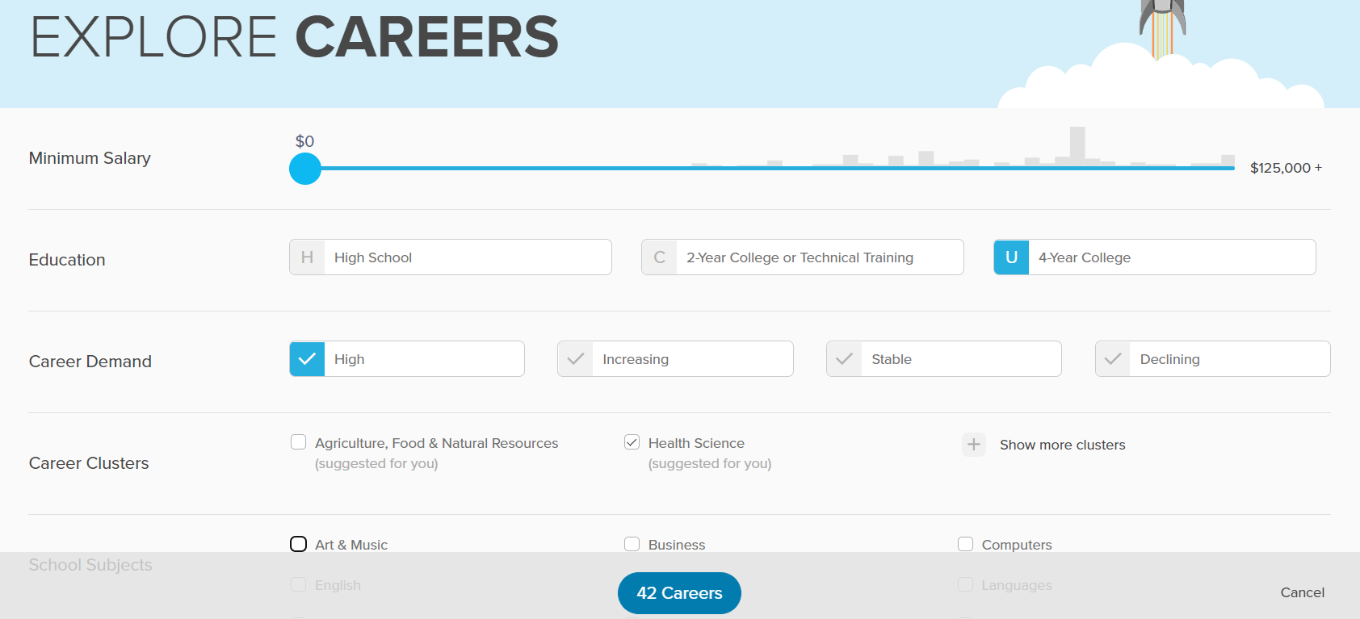

Slide 14

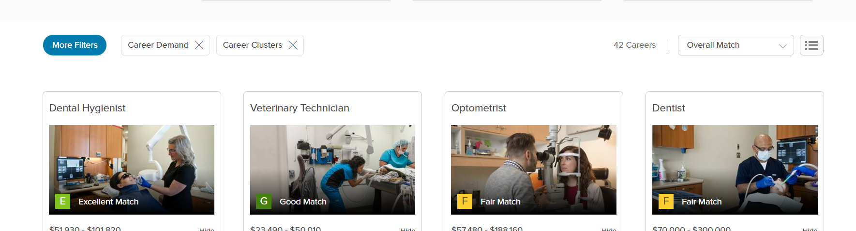

Read through your career matches

Slide 15
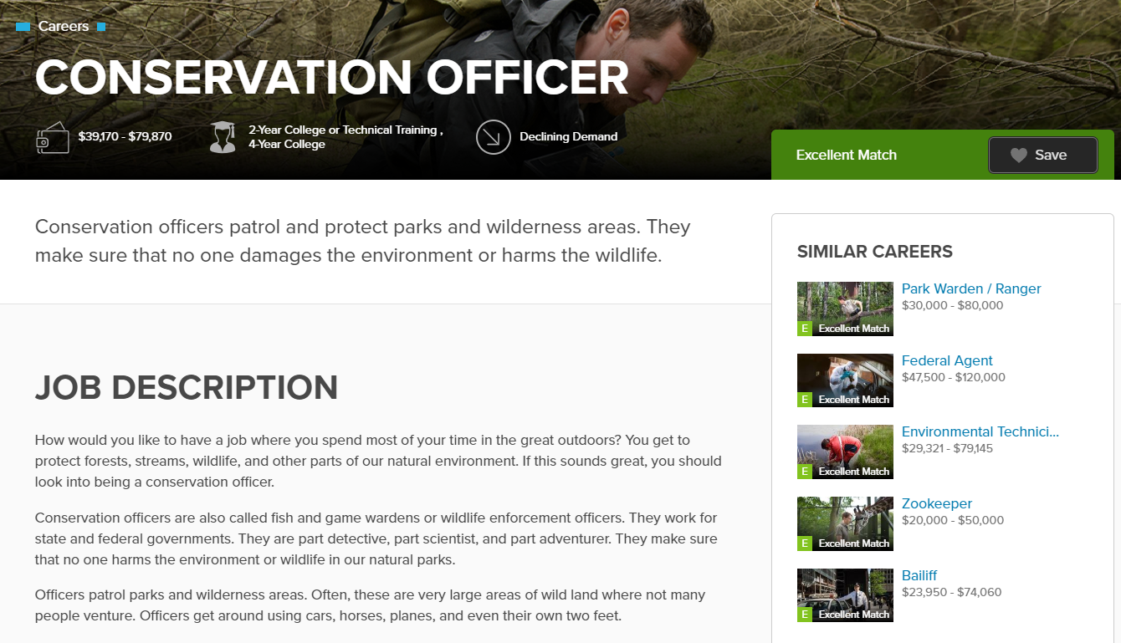
Save your top 2 careers

Slide 16
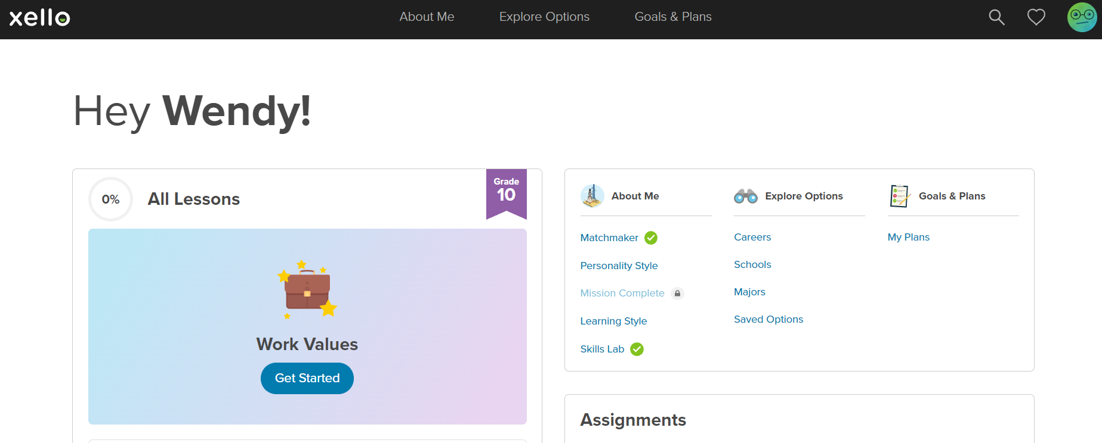

Slide 17
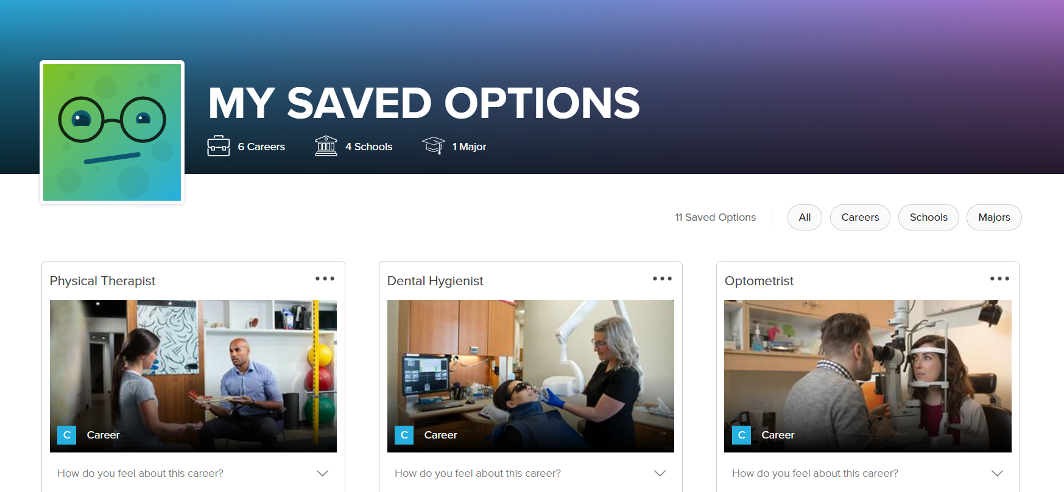

Slide 18
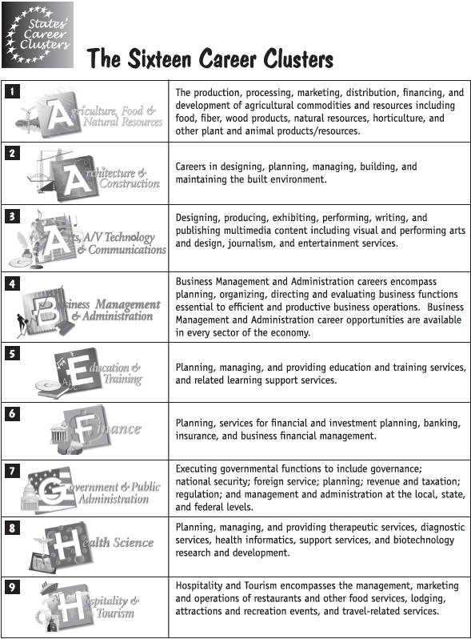
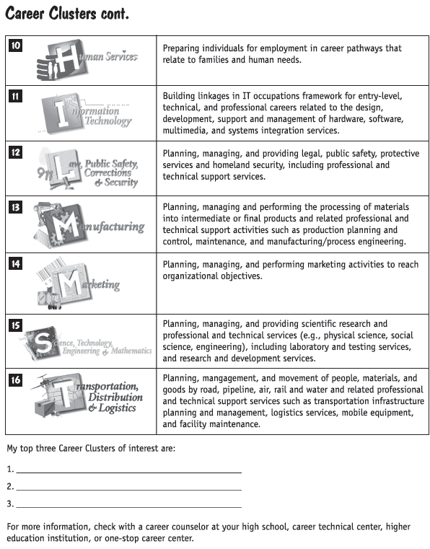
16 Career Clusters
Interest Inventory

Slide 19
LHScounseling.com

Slide 20
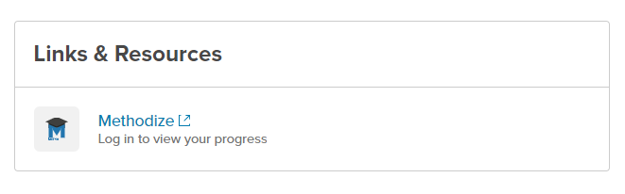
SDMyLife.com
Student log in for Methodize
Username = k12 email address
Password = Chromebook log-in password

