Slide 1
College and Career Decision Making

Slide 2
LHScounseling.com

Slide 3
Objectives
Recognize the importance of post-secondary planning for achieving career goals.
Identify resources for career and post-secondary planning information.
Compile relevant information for making an informed decision.

Slide 5
Hot Careers 2020-2030 South Dakota Dept. of Labor and Regulation
Hot Careers (High Demand-High Wage Occupations)
The current list of Hot Careers were identified in August 2022. There are currently 69 South Dakota occupations making the cut as "Hot Careers." Of those 69, the 30 occupations projected to have the greatest demand for workers are identified as the "Top 30."
https://dlr.sd.gov/lmic/publications/general/top_30_hot_careers_2022.pdf

Slide 6
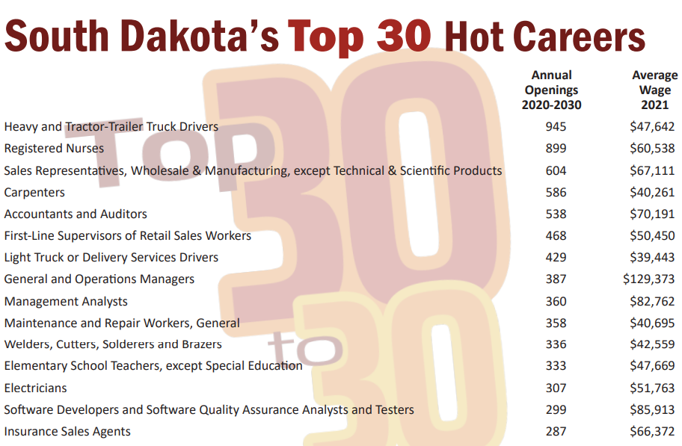

Slide 8
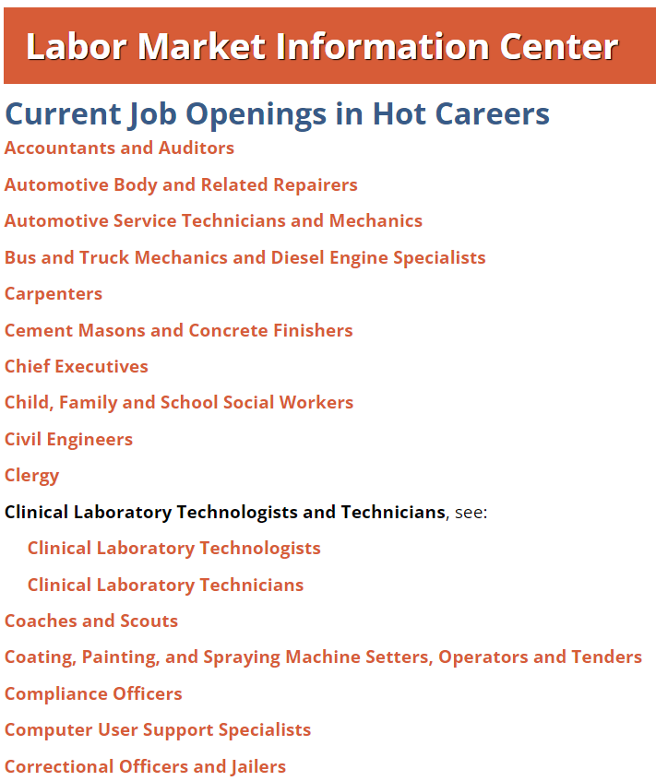
Current Job Openings for Hot Careers in SD
https://dlr.sd.gov/lmic/hot_careers_current_openings.aspx

Slide 9
Job Shadowing

Slide 10
Earnings and Unemployment Rates by Educational Level

Slide 11
SD College Admission Requirements
Rank in top 60% of graduating class
OR
Achieve an ACT composite score of 18 or higher
OR
Obtain a H.S. GPA of at least 2.6
***Exceptions
SD School of Mines and Technology (20 for review, 25 automatic w/ math subscore of 25)
USD (21 or top 50%)

Slide 12
College Course Placement
College Course | ACT Subject-Area Test | The ACT Benchmark
English Composition | English | 18
College Algebra | Math | 22
Social Sciences | Reading | 22
Biology | Science | 23

Slide 13
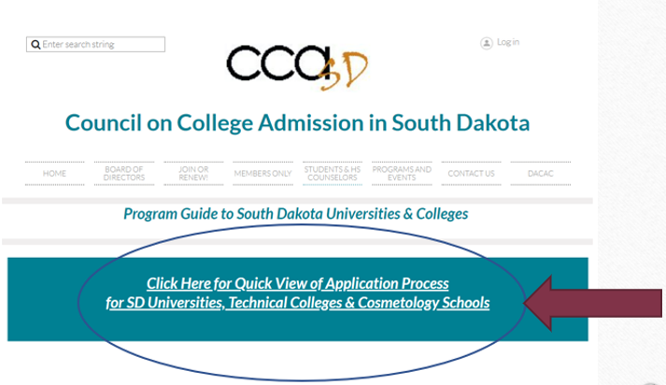
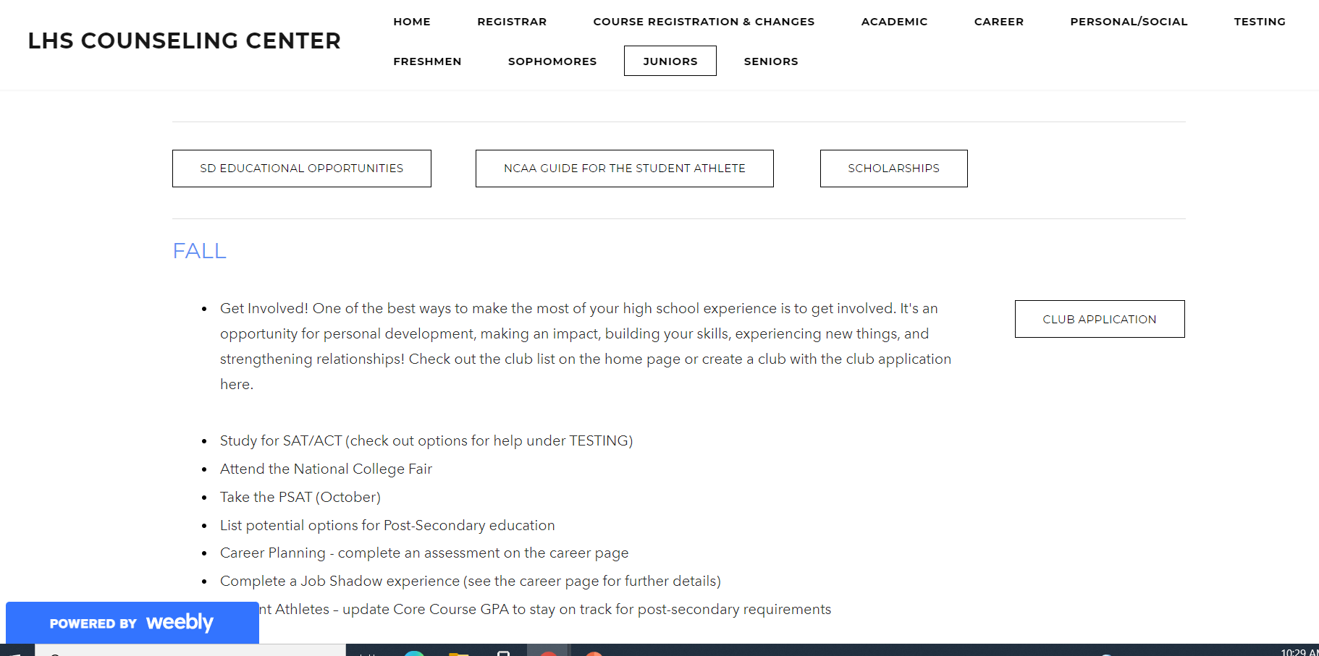
Educational Opportunities in South Dakota

Slide 14
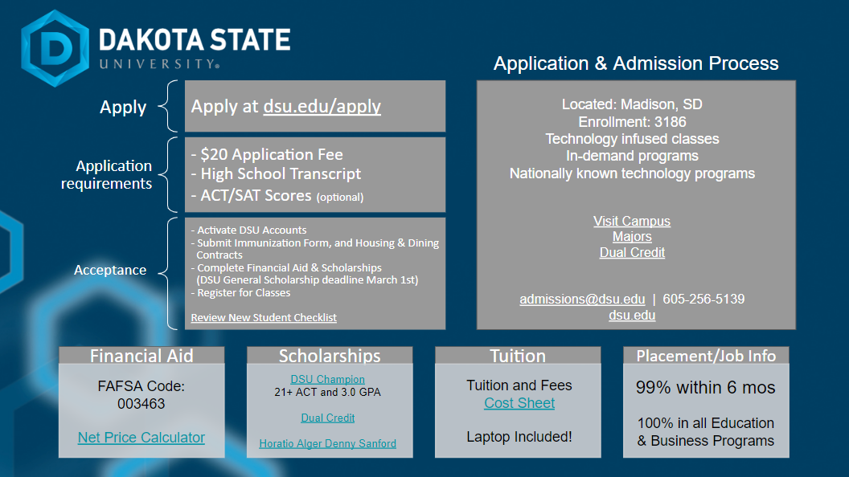

Slide 15
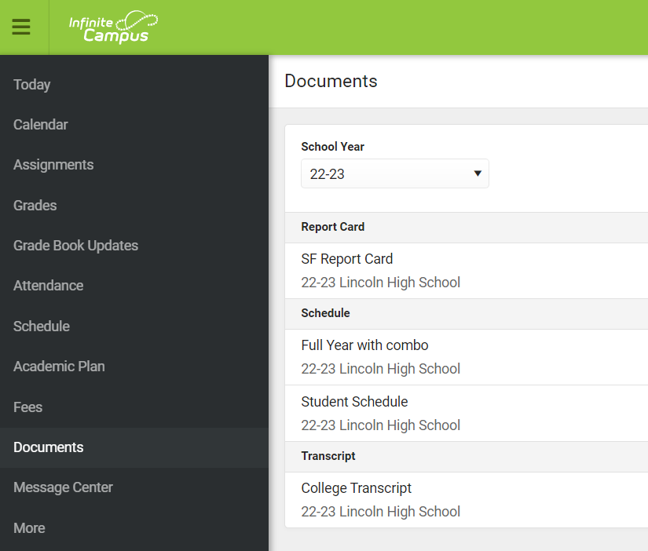

Slide 17
Regental Merit Based Scholarships

Slide 18
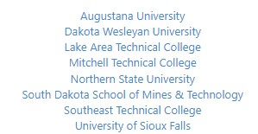
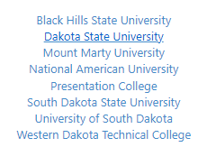
SD Opportunity Scholarship

Slide 20
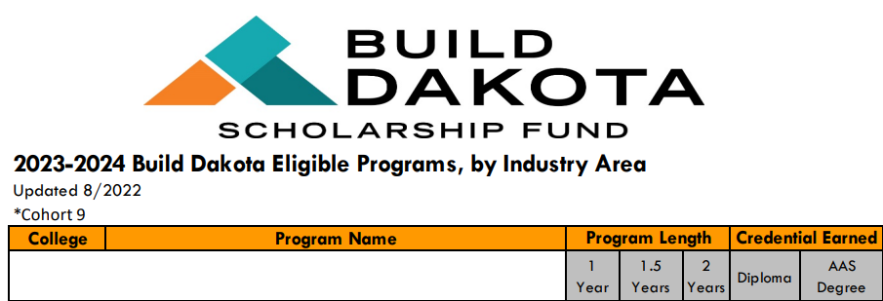
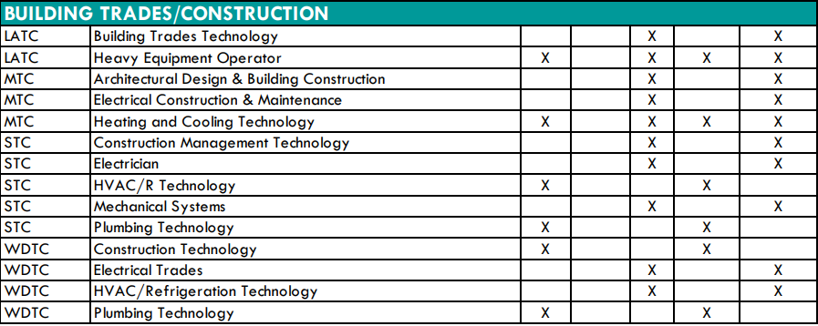
Build Dakota Full List of Eligible Programs

Slide 21
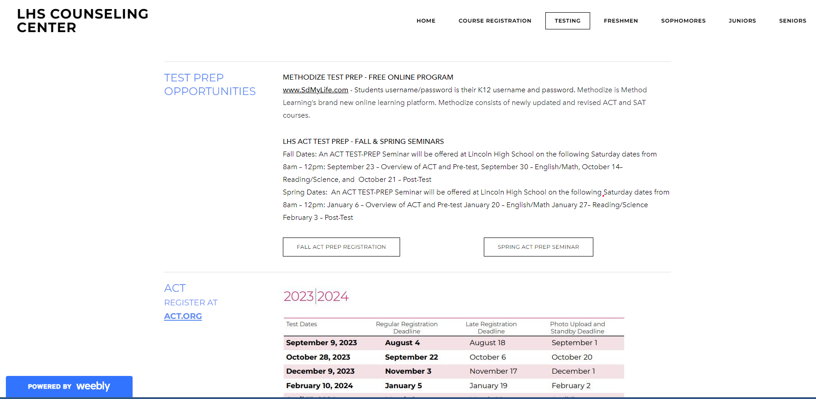
Registering for the ACT/SAT

Slide 22
SDMyLife.com

Slide 23
SDMyLife.com
Username: k12 email
Password: Chromebook log in password
First letter of your first name capitalized
First letter of your last name lower case
student ID #
4-digit birth year

Slide 24
SDMyLife.com
Free ACT & SAT Test Prep (bottom right-hand corner once logged into SDMyLife.com)

Slide 25
SdMyLife.com
Explore Options Tab
Explore Schools
Explore Majors

Slide 26
LHScounseling.com

