Slide 1
Planning your Academic Future
Your Guide to the Personal Learning Plan

Slide 2
WHAT ARE WE DOING?
Create
Differentiate
Recognize
Complete
Create an academic plan that meets graduation requirements.
Differentiate between the requirements for high school graduation and the SD Opportunity Scholarship (SDOS).
Recognize elective options available.
Complete a plan expressing career goals through course selection.

Slide 3
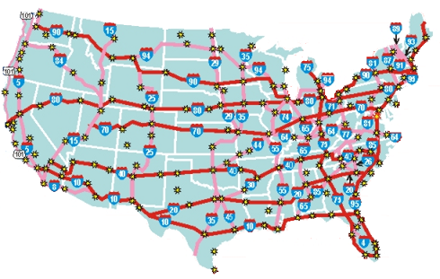
Why are we doing it?
Planning can help you…
know how to get to where you are going.
You have 4 years to get to graduation. What is the best route for you?

Slide 4
LHScounseling.com
Take the Pre-Test

Slide 5
Graduation Requirements
English Social Studies Math Science Fine Arts PE Health Economics/Personal Finance CTE/World Language Requirement Electives Total Credits Needed | 4 credits 3 credits 3 credits 3 credits 1 credit ½ credit ½ credit (or MS) ½ credit 1 credit 5½-6 credits 22 credits

Slide 6
South Dakota Opportunity Scholarship Requirements
English Social Studies Math (Alg. I, Geometry, Alg. II or Higher) Science (including 3 lab sciences) Fine Arts PE Health Economics/Personal Finance CTE/World Language Requirement Electives Total Credits Needed Extra Requirements ACT score – 24 or above C’s and above in core curriculum GPA – 3.0 or above | 4 credits 3 credits 4 credits 4 credits 1 credit ½ credit ½ credit (or MS) ½ credit 2 credits 2½-3 credits 22 credits

Slide 7
ENGLISH
Required for Regular or SDOS
English I 1.0 credit
English II 1.0 credit
English III 1.0 credit
Speech or Debate 0.5 credit
English Selective 0.5 credit
Total 4.0 credit

Slide 8
MATH
REGULAR
Algebra I 1.0 credit
Geometry 1.0 credit
Algebra II 1.0 credit
Total 3.0 credit
SDOS
Algebra I 1.0 credit
Geometry 1.0 credit
Algebra II 1.0 credit
Advanced Math 1.0 credit
Total 4.0 credit

Slide 9
SCIENCE
REGULAR
Biology 1.0 credit
Any Physical Science 1.0 credit
Chemistry or Physics 1.0 credit
Total 3.0 credit
SDOS
Biology 1.0 credit
Any Physical Science 1.0 credit
Chemistry or Physics 1.0 credit
Advanced Science 1.0 credit
Total 4.0 credit

Slide 10
SOCIAL STUDIES
Required for Regular or SDOS
US History 1.0 credit
Geography 0.5 credit
World History 0.5 credit
Government 0.5 credit
Soc Studies Selective 0.5 credit
Total 3.0 credit

Slide 11
OTHER
REGULAR
Fine Arts 1.0 credit
PE 0.5 credit
Pers Finance/Econ 0.5 credit
Health 0.5 credit
World Lang or CTE 1.0 credit
SDOS
Fine Arts 1.0 credit
PE 0.5 credit
Pers Finance/Econ 0.5 credit
Health 0.5 credit
World Lang or CTE 2.0 credit

Slide 12
ELECTIVES
REGULAR
Electives 5.5-6 credits (health in m.s.?)
SDOS additional requirements
Advanced Math 1.0 credit
Advanced Science 1.0 credit
World Lang or CTE 1.0 credit
Electives 2.5-3.0 credit

Slide 13
LHScounseling.com
Take the Post-Test

Slide 15
Infinite Campus – Academic Plan

Slide 16
www.LHScounseling.com
Course Registration Tab - HS Coursebook
Career cluster info pages 6-14

Slide 17
LOOK FOR:
DESCRIPTION OF COURSE
LENGTH/CREDIT
One Year vs One Semester
0.5 vs 1.0 credit received
PREREQUISITES
NOTES ABOUT COURSE:
Graduation requirement met
School where it is offered
Other expectations

Slide 18
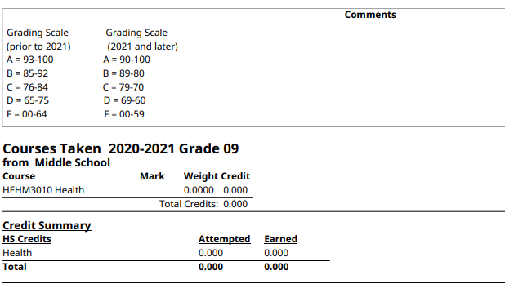
INFINITE CAMPUS
MS Health
DOCUMENTS
COLLEGE TRANSCRIPT
GPA

Slide 19
CALCULATE YOUR GPA
HOW TO VIDEO:
HTTPS://WWW.YOUTUBE.COM/WATCH?V=0P4REIMJQZU
CALCULATOR:
HTTPS://WWW.CALCULATOR.NET/GPA-CALCULATOR.HTML

